Slide 1

MOMENTUM AND COLLISION
Presented By: Mr. mark ofori nketia

Slide 2
MOMENTUM AND COLLISIONS
Conservation Of Linear Momentum
Principle of conservation of linear momentum States that if two or more bodies in a closed or isolated system collide, their total momentum before collision is equal to their total momentum after collision.
In a closed system (i.e there is no external force or interference), Momentum before collision = momentum after collision. (Mass * velocity)before collision = (Mass * velocity) after collision Note that the principle of the conservation law of linear momentum emanates from Newton’s second and third law of motion.

Slide 3
Types Of Collision
There are two types of collisions: elastic collision and inelastic collision. 1. Elastic collision: Elastic collision is the type of collision whereby the colliding objects bounce back with the same amount of velocity or different amount of velocities. The colliding objects do not stick together. In elastic collision, both kinetic energy and momentum are conserved. Examples Of Elastic Collision: Collision of ball and a wall Collision of gas molecules

Slide 4
2. Inelastic Collision: Inelastic collision is the type of collision whereby the colliding objects stick together and move with a common velocity v. In inelastic collision, only momentum that is conserved. Kinetic energy is loss because the kinetic energy is converted into sound energy, heat energy.

Slide 5
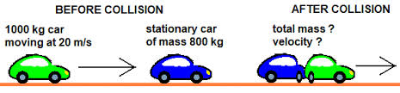
Different Cases Of Collision:
1.When A Moving Object Collides With A Stationary Object, Stick Together and Move With Common Velocity, V:

Slide 6
Momentum: Form the conservation law of momentum: Momentum of the two objects before collision: = momentum of M1 + momentum of M2 = M1*U1 + M2*U2 Momentum of the two objects after collision: = momentum of M1 + momentum of M2 = M1*V + M2*V = V ( M1 + M2 ) Let us combine the momentum of the Momentum of objects before collision = momentum of objects after collision M1*U1 + M2*U2 = M1*V + M2*V Factorize V: M1*U1 + M2*U2 = V ( M1 + M2 ) Remember that U2 = 0 m/s ( the is at rest / stationary ) Then we will get M1*U1 + M2* ( 0 ) = v ( M + M2 ) M1*U1 + 0 = V ( M1 + M2 ) M1*U1 = V ( M1 + M2 ) Make V the subject: V = ( M1*U1 ) / ( M1 + M2 )

Slide 7
Loss in Kinetic Energy:
Loss in kinetic energy can be calculated as follows:
• Calculate the kinetic energy of the two objects before collision
• Calculate the kinetic energy of the two objects after collision
• Then find the difference between the two kinetic energise to get the kinetic energy loss.
Therefore,
Kinetic energy loss = K.E before collision – K.E after collision
K.E of the two objects before collision = ½*(M1)*(U1)² + ½*(M2)*(0)²
= ½*(M1)*(U1)² + 0
. = ½*(M1)*(U1)²
Also,
K.E of the two objects after collision = ½*M1*V² + ½*M2*V²
Factorize V and ½ : ½*( M1 + M2 )V²
Therefore,
Kinetic energy loss = K.E before collision – K.E after collision

Slide 8
CASE 2
When A Moving Object Collides With A Stationary Object and They Move In The Same Direction With Different Velocities
M1*U1 + M2*U2 = M1*V1 + M2*V2 Remember that U2 = 0 m/s ( the is at rest / stationary ) Then we will get M1*U1 + M2* ( 0 ) = M1*V1 + M2*V2 M1*U1 + 0 = M1*V1 + M2*V2 M1*U1 = M1*V1 + M2*V2

Slide 9
Kinetic energy loss = K.E before collision – K.E after collision
Loss in kinetic energy = ½*M1*(U1)² - ½*( M1*(V1)²+ M2*(V2)²)

Slide 10
Thus: (M1)*(U1)² = M1*(V1)²+ M2*(V2)²
(M1)*(U1)² - M2*(V2)² = M1*(V1)²
Make (V1)² the subject: (V1)² = ( M1*(V1)² - M2*(V2)² ) / M1
Make V1 the subject: V1 = √ ((M1*(V1)² - M2*(V2)²) / M1 ).

Slide 11
CASE 3
When Two Objects That Move In The Same Direction Collide, Stick Together And Move With A Common Velocity
Kinetic energy of the two objects before collision =
K.E of M1 + K.E of M2 = ½*(M1)*(U1)² + ½*(M2)*(U2)²
Also, Kinetic energy of the two objects after collision
= K.E of M1 + K.E of M2
Kinetic energy loss = K.E before collision – K.E after collision

Slide 12
CASE 4
When Two Objects Move In Opposite Directions Collide and Move With Different Velocity In The Same Direction:
Kinetic energy of the two objects before collision = K.E of M1 + ( - K.E of M2 ) = ½*(M1)*(U1)² + ( - ½*(M2)*(U2)² ) = ½*(M1)*(U1)² - ½*(M2)*(U2)² Factorize ½: = ½ ((M1)*(U1)² - (M2)*(U2)²)
Also, Kinetic energy of the two objects after collision = K.E of M1 + K.E of M2

Slide 13
CASE 5
When Tow Objects Move In Opposite Directions, Collide, Stick Together And Move With A Common Velocity In The Same Direction
Total Momentum of the two objects before collision: = momentum of M1 + ( - momentum of M2 ) = M1*U1 + (- M2*U2) = M1*U1 - M2*U2 Momentum of the two objects after collision: = momentum of M1 + momentum of M2 = M1*V + M2*V Factorize V: = ( M1 + M2 ) V

Slide 14
Application Of Newton’s Law And Conservation Law Of Momentum:
Recoil Of A Gun: The principle of conservation of linear momentum is applied in the recoil of a gun when it is fired. When a gun is fired, the bullet is energized by a forward force ( action ) which moves it forward with a certain velocity. The bullet therefore has a forward momentum. As the bullet leaves the gun, it exert a backward force ( reaction ) on the gun. The gun then jerk backward with certain amount of velocity. In accordance with the conservation law of linear momentum, therefore the gun has a backward momentum which is equal in magnitude to the forward momentum of the fired bullet.

Slide 15
Let, Mg be mass of gun VG be velocity of gun Mb be mass of bullet Vg be velocity of bullet Then, momentum of gun = Mg*Vg momentum of bullet = Mb*Vb By principle of the law of conservation of linear momentum: Forward momentum of Bullet = Backward momentum of gun Therefore, Mb*Vb = Mg*Vg

Slide 16
Example
50 gram mass of bullet is fired from a gun of mass 25 kilogram with a velocity of 130 m/s. Calculate the recoil velocity of the rifle.
Solution>
Mass of gun = 2.5 kg = 2.5 * 1000 = 2500g,
mass of bullet = 30g, velocity of bullet = 130 m/s, velocity of gun = ? formula= Mb*Vb = Mg*Vg Substitution: 30 * 130 = 2500 * Vb
Make Vb subject of the formula: Vb = 30 * 130 / 2500. ➡ Vb = 1.56 m/s

Slide 17
Example:
A gun of mass 2.4kg fired 0.23kg mass of . if the recoil velocity of the gun is 21.4 m/s, calculate the velocity of the bullet. Solution: Data given in the question: Mass of gun = 2.4kg,
mass of bullet = 0.23kg,
velocity of gun = 21.4 m/s. Formula: Mb*Vb = Mg*Vg Substitution: 0.23*Vb = 2.4*21.4 Make Vb the subject: VB = 2.4*21.4 /

Slide 18
Question:
A jet burns at the rate of 250 g/s. If all the gas is ejected in one direction at the rate of 500m/s, what is the maximum weight the can have so that it can move vertically upward?

Slide 19
Weight Of A Object Inside A Lift
When a man stand in a lift or elevator, two forces act on the man. The forces are:
I. The true weight of the man which act vertically downward (w = m*g)
II. The reaction force R of the floor of the lift on the man, which act upward. We are going to look into different cases when the man is on the lift

Slide 20
Case 1: when the lift is stationary or moving with a constant velocity:
The lift is stationary or moving with constant velocity. Its acceleration is zero. ( a = 0 m/s² )
Therefore,
Weight of man = Reaction of floor = m*g

Slide 21
Case2: when the lift accelerates upward with acceleration
Since the lift move upward, it means that floor Reaction is greater than man’s weight
( I.e R > W ) Effective force that move the lift is the difference between Man’s weight and floor reaction. Effective force F = R – W
Therefore R – W = m*a R – m*g = m*a R = m*a + m*g Factorize m: R = m ( a + g )

Slide 22
Case 3: If the lift is accelerating downwards with an acceleration
Since the lift accelerates downwards, it means that the man’s weight is greater than the reaction force of the lift floor. ( W > R )
The effective force is the difference between the mans weight and the reaction force of the lift. Effective force F = man’s weight – reaction force of lift floor F = W – R If we substitute for F in F = m*a, we will get W – R = m*a M*g – R = m*a M*g – m*a = R Factorize m: m ( g – a ) = R. ➡ R = m ( g – a )

Slide 23
Case 4: when the lift is falling freely
W > R ( the lift is falling )
Effective force F = W – R Then. W – R = m*a M*g – R = m*a M*g - m*a = R
Factorize m: m( g - a ) Recall that the lift is falling freely, then a = g . Therefore, R = m ( g – g ) = ( 0 ) = 0 N

Slide 24
EXAMPLE
A 20-gram bullet moves at 10 m/s in a horizontal direction, collide a 60-gram block rest on a floor. After collision, bullet and block move together with the same speed and the same direction. What is the speed of both bullet and block.

Slide 25
Solution:
Known :
Mass of bullet (m_{P}) = 20 gram = 0.02 kg
Mass of block (m_{B}) = 60 gram = 0.06 kg
The initial speed of bullet (v_{P}) = 10 m/s
The initial speed of block (v_{B}) = 0
Wanted : The speed of bullet and block after collision (v’)

Slide 26
The collision is inelastic.
m_{P} v_{P} + m_{B} v_{B} = (m_{P} + m_{B}) v’
(0.02)(10) + (0.06)(0) = (0.02 + 0.06) v’
0.2 + 0 = 0.08 v’
0.2 = 0.08 v’
v’ = 0.2 / 0.08
v’ = 2.5 m/s

Slide 27
Example:
Two astronauts decide to toss fruit at each other. Astronaut 1 throws a 0.13 kg apple towards Astronaut 2 (right) with a speed of 1.11 m/s. Meanwhile, Astronaut 2 throws a 0.16 kg orange towards Astronaut 1 (left) with a speed of 1.21 m/s. The fruits collide, sending the orange off with a speed of 1.16 m/s at an angle of 42° below its original direction of motion. Find the final speed and direction (assume it is above its original direction of motion) of the apple. Assume an elastic collision.

Slide 28
Solution
this is a 2D collision question. But now, the problem explicitly states that the collision is elastic. This means that both momentum and kinetic energy are conserved. We should then be able to get initial and final equations for momentum and kinetic energy, and relate them using the Law of Conservation of Momentum (𝑝𝑖 = 𝑝𝑓) and the Conservation of Kinetic Energy (𝐾𝐸𝑖 = 𝐾E𝑓)

Slide 29
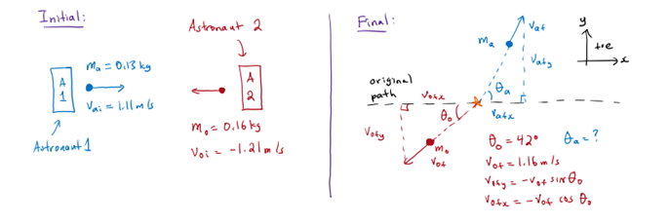

Slide 30
Now, let’s take a look at the diagram we drew, and what our next step should be. We can either analyze the momentum, or the conservation of kinetic energy. We have all the masses and velocities for the initial case. For the final case, we are missing the final velocity of the apple and its direction above the horizontal. If we choose to analyze the momentum, we’d have to split the final velocities in their x- an y-components. If we choose to analyze kinetic energy, we just need to know the initial and final velocities for each object without needing to look at their x- and y-components. That seems easier

Slide 31
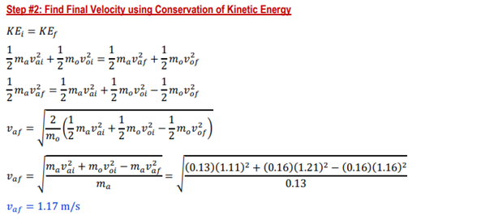

Slide 32
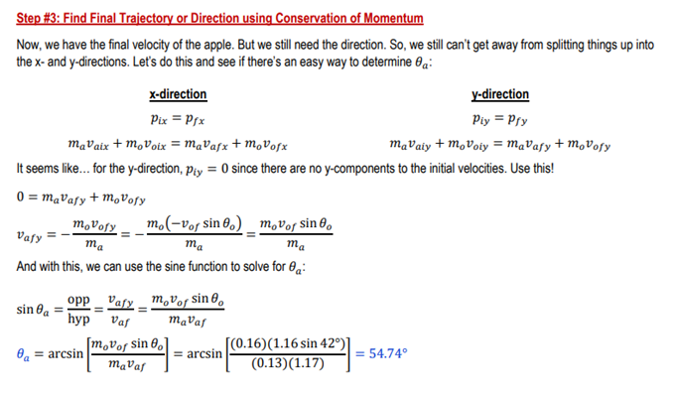
This means that the final velocity of the apple is 1.17 m/s at an angle of 54.74° above its original trajectory.

Slide 33
